Slide 1















PEOPLESOFT CAMPUS SOLUTION (PSCS)
Joy C. Bañas
AMAES Academic Information System
IT Department
In Partnership with

Slide 2

DIFFERENTIATION AND RELATIONS OF VARIOUS PORTALS

Slide 3
PSCS (Peoplesoft Campus Solution)
This is the main system and the active transactional ERP (Enterprise Resource Planning). All transactions aside from Class Records are facilitated in PSCS. This is the source of all information on all other PSCS F+ portals. Other systems are just passive so any changes / transaction that you modify here will be automatically reflected on other portals.
URL: http://oraclecampus.amaes.com/

Slide 4
USN Portal
This portal converts the temporary ID from PSCS into permanent USN after 24 hours then automatically sync the 11 digit USN to PSCS given that there is no conflict on student data upon admission. Most of the details here are for viewing purposes only aside from the facility for Student ID Card (Identification Card) request.
URL: http://usn.amaes.edu.ph/

Slide 5
PSCS F+ Unified Class Record (F+ UCR)
This is also an active transactional system where Teachers/Deans can encode grades (weighted, non-weighted, observed values, attendance). Only grades and grade values can be encoded on this system. This is a passive system so all modifications should be made on PSCS including teachers assignment, student enlistment and other necessary data.
URL: http://classrecord.amaes.com/

Slide 6
PSCS F+ RPT 1 (Functions +)
This is a report generation facility and more of a structured reports menu that will indicate detailed process and navigation of the specific report inside PSCS. It listed all the available frequently used reports.
URL: http://pscsfunctionsplus.amaes.edu.ph

Slide 7
PSCS F+ RPT 2
This also a report generation facility with cross system aggregators. Unlike the PSCS F+ RPT 1 (Functions +), this will provide a report that requires a certain period of time to sync. Which means, not on real time.
URL: http://usn.amaes.edu.ph/stepreports/alpha.asp

Slide 8
AMAES Academic Information System
PSCS
(Main System)
USN Portal
(Passive System)
F+ UCR
(Passive System)
F+ RPT 1
(Report Generation Facility)
F+ RPT 2
(Report Generation Facility)

Slide 9
SYSTEM SUPPORT

Slide 10
PSCS Support Site
This is a support site that contains detailed user guides that you can view and download depending on the specific concern. All are sorted per role and functions.
An authentication is required upon downloading the documents.
User Name: docshare
Password: ,T"y-6hh{(FcgJF
URL: http://oraclecampus.amaes.edu.ph/

Slide 11
OSSys (Online Support System)
This is an online support system sorted per module. Every concern will be provided with ticket which will automatically notify the assigned person to assist your specific concern.
URL: http://ossys.amaes.edu.ph

Slide 12
IT Helpdesk
This is direct email address of IT Helpdesk. It has the same concept with the OSSys which usually provides an assistance on any system issues.
Email Address: helpdesk@amaes.edu.ph

Slide 13
System Access
All portals require same User Name (Employee Number) and Password
All access provision, requires an approval and endorsement from your approving head. This will not be automatically provided once hired.
All system access is role based and secured based on your current role, institution and branch. Which means, you cannot view a certain role and campus facility if not tagged or added on your access.
Multiple role and campus access can be tagged or added simultaneously, aside from Registrar Role due to conflict on data security.

Slide 14
SYSTEM TESTING

Slide 15
PSCS UAT Testing
The test instance is intended for system trial and testing. You can do anything here since it won’t affect any data on the live instance. Environment, facilities and process are the same with the Live PSCS.
URL: http://oraclecampus-uat.amaes.com:8020/

Slide 16
APPLICATION– Admission Officer
(Encoding of Basic Information)
New & External Transferee
MATRICULATION – Admission Officer
(Creation of Student Program)
Old, Returnee, Internal Transferee
TERM ACTIVATION – Admission Officer
(Activating Current Term)
Basic Student Enrollment Process
ENLISTMENT – Admission Officer/Dean
(Tagging of Student Classes)
ASSESSMENT – Accounting Officer
(Tuition Calculation)
POSTING OF PAYMENT – Cashier
(Releasing of OR)
PRINTING OF COR – Accounting Officer
(Certificate of Registration)

Slide 17
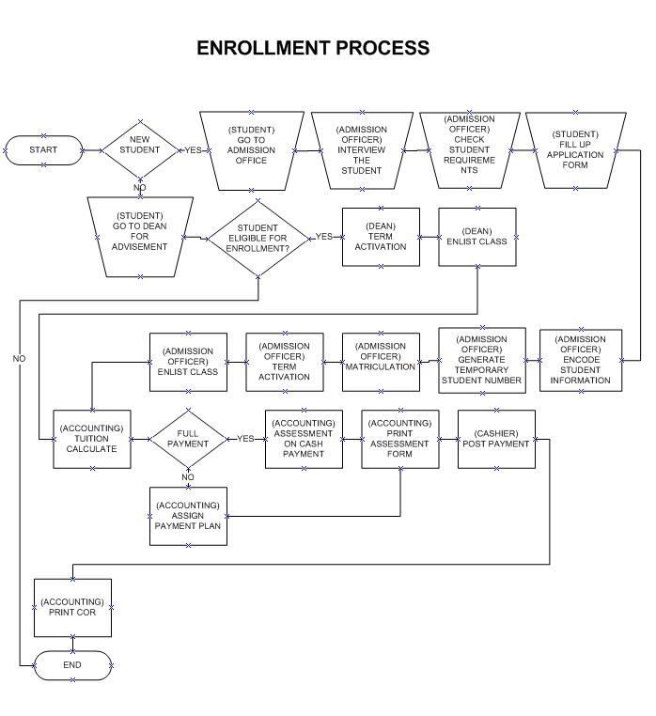
Detailed One Full Cycle

Slide 18
Differentiation and Relation of Common Terminologies (Code and Description)
Institution –Brand
Example: PH001 AMA
Campus – Branch
Example: CPH34 Quezon City
Career – Program Group
Example: UGRD Undergrad
Academic Program – Student Program
Example: 4005T Bachelor of Science in Computer Science (BSCS)
Acad Plan – Plan of specific program (Specialization)
Example: 400502T Software Development
Term – Student SY Term
Example: 1813 2018 1st Trimestral
1812 2018 1st Semestral
1811 2018 Annual

Slide 19
Synching of Grades per System
F2F (Face to Face)
Faculty ➔ Encode the grades on F+ Unified Class Record
Faculty ➔ Submit the grades on F+ Unified Class Record
Dean ➔ Recheck the faculty’s submitted grade
Dean ➔ Decide whether to Post (Confirm/ Final Lock) or Unlock the faculty’s submitted grade
Dean ➔ Process will end on Posted Grade (Final Lock)
IT HO ➔ Extract the posted grades from F+ Unified Class Record (Every end of Term)
IT HO ➔ Migrate the grades from F+ UCR going to PSCS (Every end of Term)

Slide 20
Synching of Grades per System
Blended (Online)
AMAOED ➔ Online grades will automatically added on LMS for every student transaction through online
AMAOED ➔ Extract the grades from LMS within a regular interval
IT HO ➔ Migrate the grades from LMS going to F+ UCR
IT HO ➔ Extract the posted grades from F+ Unified Class Record (Every end of Term)
IT HO ➔ Migrate the grades from F+ UCR going to PSCS (Every end of Term)

Slide 21
How to Perform Transfer Crediting
Objective:
This is intended to enable end users to perform the following:
Credit a course
Credit a course with Lecture and Laboratory Component
Credit two or more courses equivalent to a course
Credit a cross enrolled course
Encode a non-credit course
Pre requisites and Assumptions:
Before you can successfully perform the Transfer Credit processing, it is either required or
assumed that all of the following conditions has been met:
The student has submitted all their official transcripts from the external institutions
The Dean manually evaluates transfer courses, identifies the course equivalencies and units earned and approves them for crediting
The Transfer student has been matriculated and term activated
Note:
All subjects taken from Source Institution should be added on Transfer Credit Evaluation regardless if Passed, Failed, Credited or Non Credited since all grades should be reflected on AMAES TOR

Slide 22
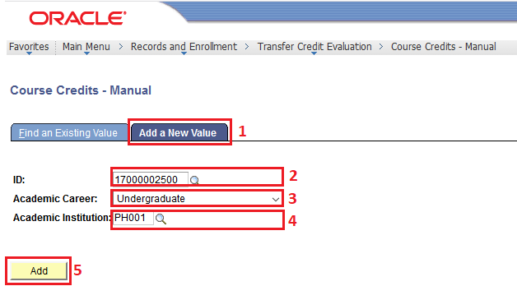
Transfer Credit Procedure:
Go to:
PSCS ➔ Records and Enrollment ➔ Transfer Credit Evaluation ➔ Course Credit Manual
Add New Value ➔ Click to add new entry
USN ➔ Input value
Academic Career ➔ Select specific career
Academic Institution ➔ Select specific institution
Add ➔ Click to Add

Slide 23
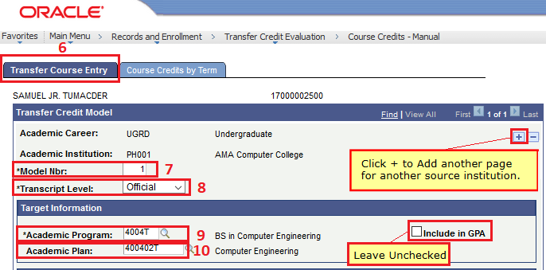
Transfer Course Entry ➔ Click to tab add new entry
Model Nbr ➔The default model number is 1
Transcript Level ➔ Select “Official” which means that the Transfer Credit is eligible to appear on all Transcript Type
Academic Program ➔ Select specific program
Academic Plan ➔ Select specific academic plan
Note:
The system by default, sets the first row of the transfer credit model to model number 1. One model corresponds to one source institution. So, if the students came from more than 1 institution, therefore, you need to create one model for each source institution.
Leave the Include in GPA option unchecked. Transfer courses are not eligible for GPA

Slide 24
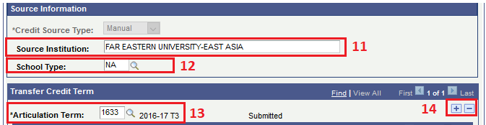
Source Institution ➔ Input the student’s External Institution prior to AMAES
School Type ➔ Select specific school type
Articulation Term ➔ The value depends on the following conditions
➔ Use Admit Term for External Transferees
➔ If the course to credit is from Internal or External Cross Enrollment, use Actual Term indicated on Certificate of Grades from Host Campus converted to AMAES Term
➔ Transfer Credit Facility is also used for Inactive or Returnee Students that requires manual migration of grades from old system going to PSCS. With this case, use student’s actual Admit Term
+ or - ➔ Click + (plus sign) to add another row or – (minus sign) to remove existing Articulation Term row.

Slide 25
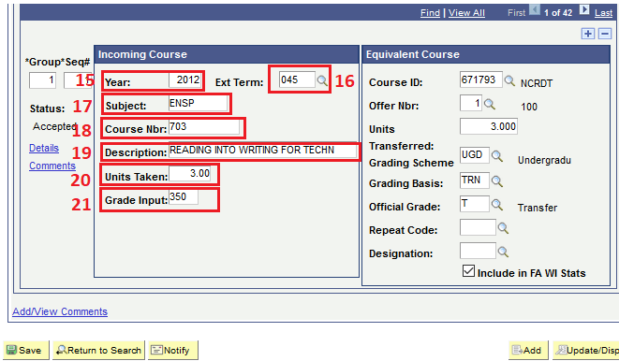
Incoming Course
Group box to define your External Course Information
Year ➔ Input the exact year when the class was taken
Ext Term ➔ Select the external term for each external course that you enter. This is the term when the class was taken.
Subject ➔ Input subject code if available
Course ➔ Input course number if available
Description ➔ Input specific class description
Units Taken ➔ Input value
Note: All Terms which are not available on Ext Term look up should be requested to HO IT to be added on the system

Slide 26
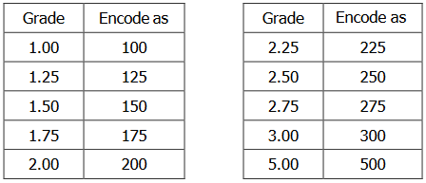
Grade Input ➔ Enter the grade received for the incoming course as reflected on the student’s Transcript from prior school
The Grade Input field is only 3 characters long. If grading system of the source institution is the same as our Institution, such as 1.00, 1.25, 1.50, etc, then encode the following grades :

Slide 27
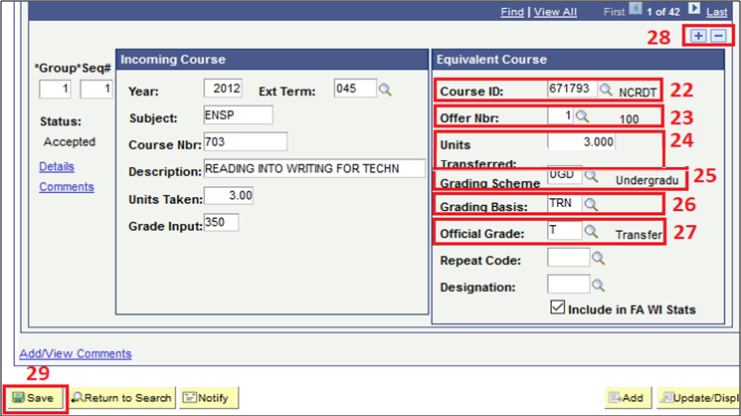

Equivalent Course
Group box to define the Internal Course that is Equivalent to the Incoming
Course. The system matches classes based on year, external term, subject, course number, units taken, and grade input.
Course ID ➔ Select specific course that is equivalent to the incoming course for this row. Use search icon to select course from course catalog
Offer Nbr ➔ By default, the system displays the offering number of the course that you selected according to the definition of the course in your academic institution's course catalog. But you can still override the default value.

Slide 28
Units Transferred ➔ The value in this field appears by default from the Units Taken field in the Incoming Course group box for the course. You can override the default value in case that you need to credit 2 or more incoming course to 1 equivalent course.
Grading Scheme ➔ The default grading scheme that we use is UGRD.
Grading Basis ➔ The default grading basis is TRN. No other grading basis should be use in credit transfer.
Official Grade ➔ Select P for Passed and F for Failed grade of the course to transfer credit or T for Transfer. Since credit courses are not included in GPA computation, there is no need to covert and track the actual grades of student for Advisement purposes.
+ or - ➔ Click + (plus sign) to add another row of course to credit or – (minus sign) to remove existing course
Save ➔ Click to save changes. Once saved, the entry status will be reflected as Submitted indicated beside Articulation Term

Slide 29
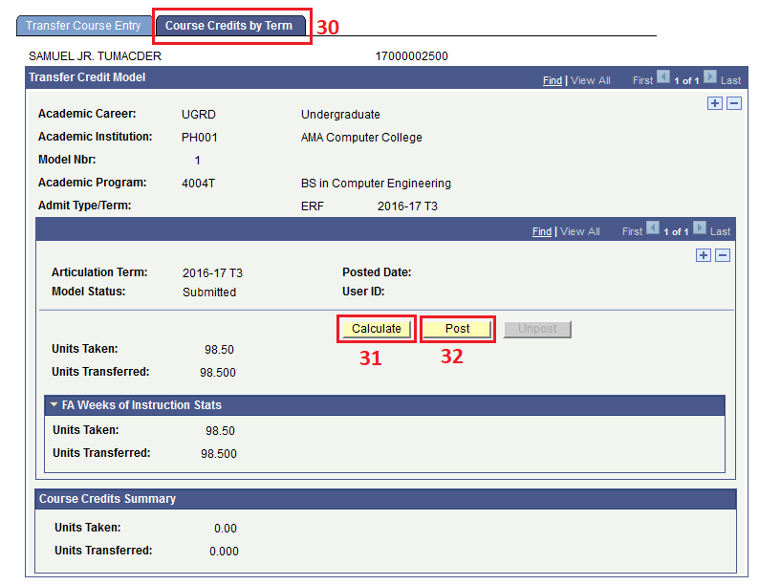
Course Credits by Term ➔ Click tab to add course credits
Calculate ➔Click button to calculate the individual's transfer credit statistics according to the accepted transfer credit on the corresponding row of the model.

Slide 30
Post ➔ Click to post an individual's transfer credit for the corresponding model. Posting automatically saves the page. When you post transfer credit, the system displays the posted transfer credit statistics according to the individual's calculated transfer credit statistics on the page.
Posting a transfer credit model also updates the status of the model from Submitted to Posted or Completed.
Submitted ➔ Indicates that you have not Posted this model but Save it instead.
Posted ➔ Indicates that you clicked the Post button and the system has successfully transferred the articulated transfer credit to the student's career term record for this model.
Completed ➔ Indicates that you have clicked Post button but that the model could not be posted because the student is not Term Activated on the term you used in the Articulation Term.

Slide 31
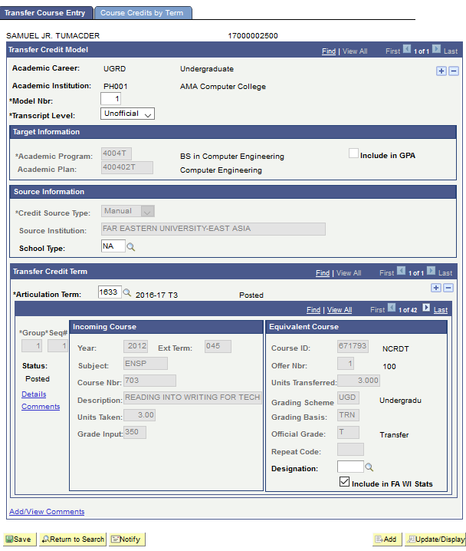
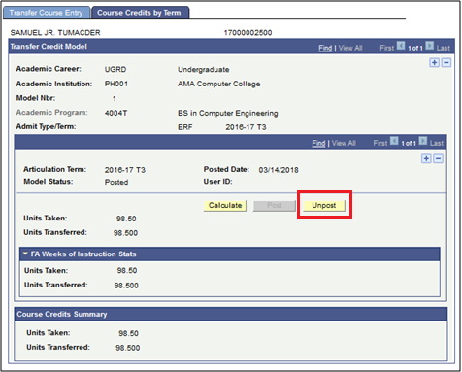
When you post your transfer credit model, the fields in the Target Information group box on the first page of the component becomes disabled. To update the target information, just click Unpost to reopen your model.
All models must be calculated and posted so everything will be reflected on the transcripts and advisement reports.

Slide 32
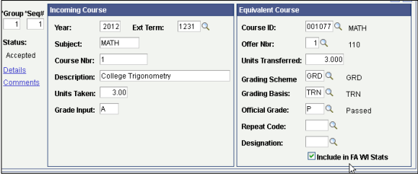
Types of Course Crediting
Credit a Course with Same Number of Units
Normal crediting will be followed, no additional instruction shall be applied

Slide 33
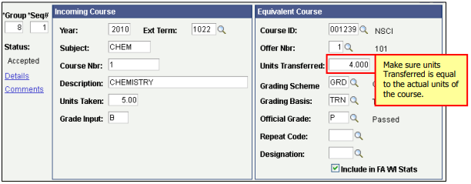
Credit a Course with Different Number of Units
A crediting course with Higher number of units can be encoded on Incoming Course as is. But the units tagged on Equivalent Course should be aligned based on the AMAES Course Catalog.
For example, CHEM 1 with 5 units (Source Institution) can be credited as NSCI 101 with 4 units (AMAES)
Note:
Incoming Course with Lesser number of units compared on what we have on AMAES (Equivalent Course) will not be accepted for crediting and should be tagged as Non Credit Course.

Slide 34
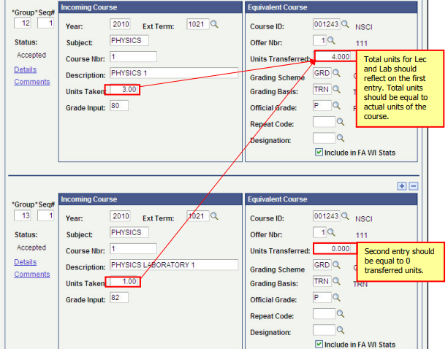
Credit a Course with Lecture and Laboratory Units
When crediting a course with separate grade for the Lecture and Laboratory component, use the Lecture component as the official course credit entry. The actual credit units of the course should also be used as Units Transferred for this purpose. Otherwise, course will not be credited properly. To record the Laboratory component, use the same Course ID as Lecture component but with 0 Transferred Units.

Slide 35
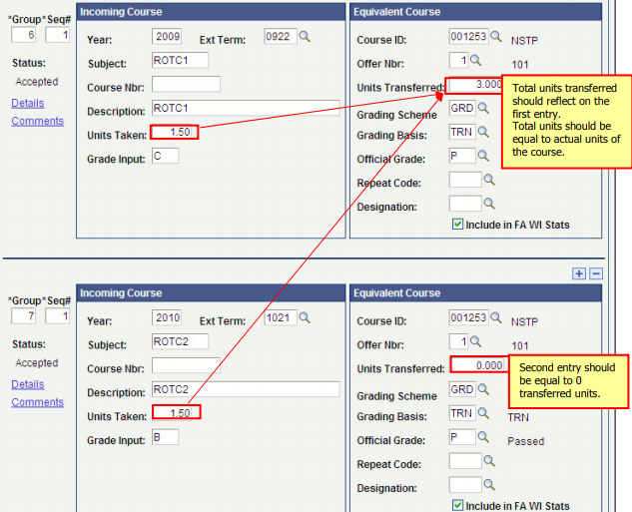
Credit Two or More Course to One Equivalent Course
When crediting 2 or more courses to an equivalent course, use the first entry as the official course credit entry. The actual credit units of the course should also be used as Units Transferred . The rest of the equivalent course should use the same Course ID but 0 for the Units Transferred.
Note:
A course not greater than 1 unit is a Non-Credit Course. Therefore, 3 incoming courses with 1 unit each cannot be credited and not equivalent to any 3 units course.

Slide 36
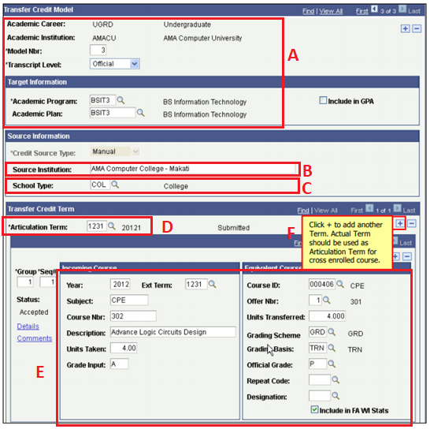
Credit Cross Enrolled Course
A cross enrolled course is considered as non-GPA course and therefore same policy on transfer crediting is applied.
Student and Program Information ➔ Input all necessary information
Source Institution ➔ Input the School where the cross enrollment was taken
School Type ➔ Select School Type
Articulation Term ➔ On cross enrollment, use the specific term when the course was taken. Additional Articulation Term is necessary for every new cross enrollment terms
Incoming and Equivalent Course ➔ Input all necessary data
+ (Plus Sign) ➔ Click to Add Row

Slide 37
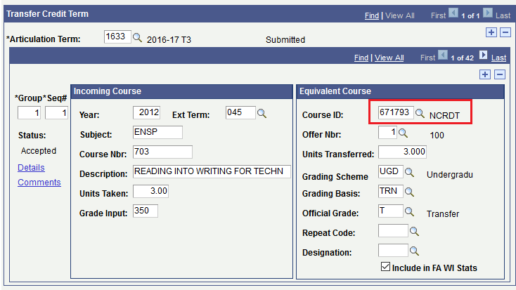
Non Credit Course
The courses that are not allowed for crediting will not be included on the credited course even if you modeled it with an equivalent course. So make sure to check which courses in the program are allowed and not allowed for crediting. A course that is not on the list of course for a specific program should be entered as a Non-Credit Course. Use Course ID 671793 NCRDT (Non Credited) under equivalent course.

Slide 38
Course in not associated with the program that the student is taking
Failed Grades
Incoming Course with Lesser number of units compared on what we have on AMAES (Equivalent Course) will not be accepted for crediting
A course not greater than 1 unit is a Non-Credit Course. Therefore, 3 incoming courses with 1 unit each cannot be credited and not equivalent to any 3 units course.
Note:
Refer to the Academic List of Non Credit Course per Program

Slide 39
Cross Enrollment Procedure
Cross enrollment is allowed on both graduating and non-graduating students. But overload is acceptable only to graduating students until the maximum units and not to exceed by 27 units.
Cross Enrollment request and overloading both requires an approval from ACR Head Marlene Miranda
Once approved, Home campus should coordinate with AMAOEd (AMA University Online Education) to recheck the specific class if available via online
If Available, do the process of admission, enlistment and payment as instructed by AMAOEd
If Not Available, request for a Certification of Non Availability of Class from AMAOEd to be endorsed to ACR (AMAES Chief Registrar)
Once verified by ACR, Home Campus should coordinate with the nearest Host Campus with available class. Be reminded that enrollment should be made within the same Institution only. Cross enrollment on different Institution is not recommended due to different amount of fees per Institution

Slide 40
Admission, Enlistment, Assessment and Payment should be done manually. No transaction should be made or encoded inside PSCS or any other system
Host Campus will receive a Cross Enrollment Fee, while the Home Campus will accept the entire assessed fees
Once the Class is completed, Host Campus will provide Certification of Grade to be submitted on Home Campus. Still, no transaction should be made or encoded inside PSCS or any other system
Home Campus Dean will add the grades on student data on PSCS thru Transfer Credit (See Transfer Credit Rules)
All External Cross Enrollees (Non AMAES student) have an option to cross enroll via Online (AMAOEd) or F2F (Face to Face). Only Internal Cross Enrollees (AMAES Student) are mandated to check first the availability of class on AMAOEd.

